Slide 1

Intelligent Fault Diagnosis for Electric Power Distribution System
NHA TRANG UNIVERSITY
Department of Electrical and Electronic Engineering
Academic report
Reporter: Dr. Thi Thom Hoang
April, 2018
Notes:
----- Meeting Notes (9/1/11 20:15) -----

Slide 2
Contents
1
Feeder automation system (FAS)
2
Support vector machine (SVM)
3
Particle swarm optimization (PSO)
4
PSO-based SVM
5
Simulation Results
Chapter 7
Conclusion

Slide 3

Motivation
Fig .1 Short-circuit fault

Slide 4
Paper review
Fault diagnosis methods
Impedance based method
Travelling wave based method
Artificial intelligence
TDR
Wavelet
ANN
SVM
Fig. 2 Fault diagnosis methods

Slide 5
Contribution
Developing variants of PSO, namely Mutant particle swarm optimization (Mutant PSO).
Developing perturb particle swarm optimization (PPSO) variant.
Developing a modified version of PSO, namely differential particle swarm optimization (DPSO).
Constructing an enhanced ANN/SVM classifiers using PSO and its variants to diagnose fault in distribution system

Slide 6

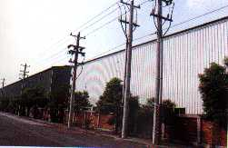




Feeder Automation System
Server groups of system data
TPC’s PC and OMS server
Server group of application
Workstation of dispatcher
RAID
firewall
FEP
Server group of communication
GPS
FRTU
…
TPC DDCS

Slide 7
FAS
SVM
PSO
Proposed method
Simulation Results
Conclusion
FDIR
FCB: Feeder Circuit Breaker
MTR: main transformer
LBS：Load Break Switch
CB：Circuit Breaker
Fig. 4 The function diagram of FDIR

Slide 8
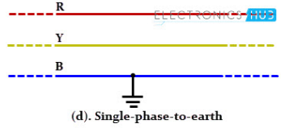
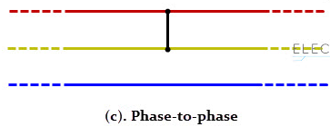
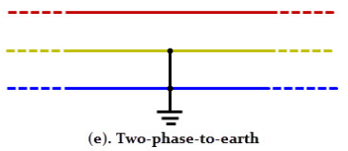
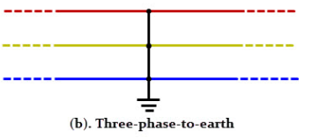
FAS
SVM
PSO
Proposed method
Simulation Results
Conclusion
Types of fault
(AG, BG, CG)
(AB, AC, BC)
(ABG, ACG, BCG)
(ABC)
Fig. 5 The types of fault

Slide 9
FAS
SVM
PSO
Proposed method
Simulation Results
Conclusion
Time Domain Reflectometry (TDR)
Fig. 6 Diagram of a time domain reflectometer
Using TDR with PRBS stimulus, calculating cross-correlation (CCR) of the reﬂected response with the incident PRBS:

Slide 10
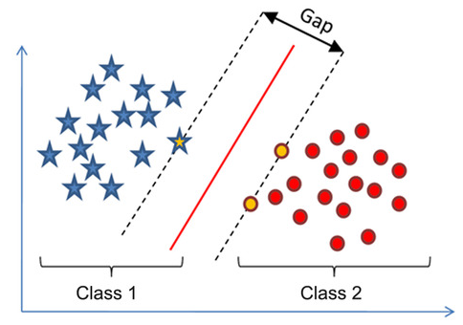

FAS
SVM
PSO
Proposed method
Simulation Results
Conclusion
Introduction
SVM was first mentioned by Vapnik in 1995
Based on a combination between the structural risk minimization (SRM) principle and statistical learning theory (SLT)
text categorization
image classification
regression
classification
fault detection
bioinformatics
Notes:
Astley and Fombrun, 1983 -- Dependence on economic individual (1.Alliance of vertical interdependent; 2. Alliance of horizontal independent; 3. Alliance of opposite relation)
Porter and Fuller, 1986 --Valued activities (1. R&D alliance; 2. Operation and logistics alliance; 3. Marketing and service alliance; 4. Multiple activities)
-- Geographic location (1. Single country alliance; 2. Multinational alliance)
-- Activities in the industry value chain (1. X alliance: alliance of vertical specialization; 2. Y alliance: alliance of horizontal specialization
Lei and Slocum, 1992 -- Cooperative strategic focal point (1. Authorized; 2. Joint venture; 3. Alliance in common R&D).
Lorange, 1998 -- Alliance partners interdependent extent (1. Equity; 2. Non-equity; 3. Marketing/managerial service agreement; 4. Specialized knowledge authorization; 5. Franchise authorization; 6. Patent authorization; 7. Production/assemble/purchase agreement)

Slide 11
FAS
SVM
PSO
Proposed method
Simulation Results
Conclusion
Linear SVM
Support vector learning finds a separating hyperplane (x∙ϕ) = c that separates the positive subset I (y = 1) from the negative subset II (y= -1) with the largest margin.
Support Vectors are those datapoints that the margin pushes up against
Fig. 7 The optimal separating hyperplane
Notes:
Astley and Fombrun, 1983 -- Dependence on economic individual (1.Alliance of vertical interdependent; 2. Alliance of horizontal independent; 3. Alliance of opposite relation)
Porter and Fuller, 1986 --Valued activities (1. R&D alliance; 2. Operation and logistics alliance; 3. Marketing and service alliance; 4. Multiple activities)
-- Geographic location (1. Single country alliance; 2. Multinational alliance)
-- Activities in the industry value chain (1. X alliance: alliance of vertical specialization; 2. Y alliance: alliance of horizontal specialization
Lei and Slocum, 1992 -- Cooperative strategic focal point (1. Authorized; 2. Joint venture; 3. Alliance in common R&D).
Lorange, 1998 -- Alliance partners interdependent extent (1. Equity; 2. Non-equity; 3. Marketing/managerial service agreement; 4. Specialized knowledge authorization; 5. Franchise authorization; 6. Patent authorization; 7. Production/assemble/purchase agreement)

Slide 12
FAS
SVM
PSO
Proposed method
Simulation Results
Conclusion
Non-linear SVM
General idea: the original input space is non-linearly transformed into a higher-dimensional kernel space where the training set is separable
Φ: x → φ(x)
Fig. 8 The mapping structure of SVM
Notes:
Astley and Fombrun, 1983 -- Dependence on economic individual (1.Alliance of vertical interdependent; 2. Alliance of horizontal independent; 3. Alliance of opposite relation)
Porter and Fuller, 1986 --Valued activities (1. R&D alliance; 2. Operation and logistics alliance; 3. Marketing and service alliance; 4. Multiple activities)
-- Geographic location (1. Single country alliance; 2. Multinational alliance)
-- Activities in the industry value chain (1. X alliance: alliance of vertical specialization; 2. Y alliance: alliance of horizontal specialization
Lei and Slocum, 1992 -- Cooperative strategic focal point (1. Authorized; 2. Joint venture; 3. Alliance in common R&D).
Lorange, 1998 -- Alliance partners interdependent extent (1. Equity; 2. Non-equity; 3. Marketing/managerial service agreement; 4. Specialized knowledge authorization; 5. Franchise authorization; 6. Patent authorization; 7. Production/assemble/purchase agreement)

Slide 13
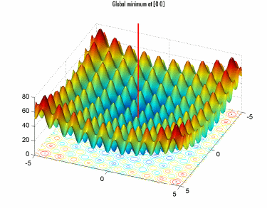
FAS
SVM
PSO
Proposed method
Simulation Results
Conclusion
PSO Algorithm
In every iteration, each particle is updated by following two "best" values:
- The first one is the best solution (fitness) it has achieved so far: pbest
- Another "best" obtained so far by any particle in the population: gbest.
The particle updates its velocity and positions:
Notes:
Astley and Fombrun, 1983 -- Dependence on economic individual (1.Alliance of vertical interdependent; 2. Alliance of horizontal independent; 3. Alliance of opposite relation)
Porter and Fuller, 1986 --Valued activities (1. R&D alliance; 2. Operation and logistics alliance; 3. Marketing and service alliance; 4. Multiple activities)
-- Geographic location (1. Single country alliance; 2. Multinational alliance)
-- Activities in the industry value chain (1. X alliance: alliance of vertical specialization; 2. Y alliance: alliance of horizontal specialization
Lei and Slocum, 1992 -- Cooperative strategic focal point (1. Authorized; 2. Joint venture; 3. Alliance in common R&D).
Lorange, 1998 -- Alliance partners interdependent extent (1. Equity; 2. Non-equity; 3. Marketing/managerial service agreement; 4. Specialized knowledge authorization; 5. Franchise authorization; 6. Patent authorization; 7. Production/assemble/purchase agreement)

Slide 14
FAS
SVM
PSO
Proposed method
Simulation Results
Conclusion
If f (X_{p}^{k+1}) < f (Pbest_{p}^{k}) then Pbest_{p}^{k+1} = X_{p}^{k+1} else Pbest_{p}^{k+1} = Pbest_{p}^{k}
If f (X_{p}^{k+1}) < f (Gbest^{k}) then Gbest^{k} = X_{p}^{k+1} else Gbest^{k+1} = Gbest^{k}
Fig. 9 The flowchart of PSO
Notes:
Astley and Fombrun, 1983 -- Dependence on economic individual (1.Alliance of vertical interdependent; 2. Alliance of horizontal independent; 3. Alliance of opposite relation)
Porter and Fuller, 1986 --Valued activities (1. R&D alliance; 2. Operation and logistics alliance; 3. Marketing and service alliance; 4. Multiple activities)
-- Geographic location (1. Single country alliance; 2. Multinational alliance)
-- Activities in the industry value chain (1. X alliance: alliance of vertical specialization; 2. Y alliance: alliance of horizontal specialization
Lei and Slocum, 1992 -- Cooperative strategic focal point (1. Authorized; 2. Joint venture; 3. Alliance in common R&D).
Lorange, 1998 -- Alliance partners interdependent extent (1. Equity; 2. Non-equity; 3. Marketing/managerial service agreement; 4. Specialized knowledge authorization; 5. Franchise authorization; 6. Patent authorization; 7. Production/assemble/purchase agreement)

Slide 15
FAS
SVM
PSO
Proposed method
Simulation Results
Conclusion
Mutant-PSO
The mutant-particle is denoted as Mbest
and can be generated as follows:
for q = 1: D
Mbest_{q}=Pbest(randi(N,1), q)
end
.
If f (Mbest^{k+1}) < f (Pbest^{k}_{worst}) then Pbest _{worst}^{k+1} = Mbest^{k+1}
Fig. 10 The flowchart of Mutant PSO
Notes:
Astley and Fombrun, 1983 -- Dependence on economic individual (1.Alliance of vertical interdependent; 2. Alliance of horizontal independent; 3. Alliance of opposite relation)
Porter and Fuller, 1986 --Valued activities (1. R&D alliance; 2. Operation and logistics alliance; 3. Marketing and service alliance; 4. Multiple activities)
-- Geographic location (1. Single country alliance; 2. Multinational alliance)
-- Activities in the industry value chain (1. X alliance: alliance of vertical specialization; 2. Y alliance: alliance of horizontal specialization
Lei and Slocum, 1992 -- Cooperative strategic focal point (1. Authorized; 2. Joint venture; 3. Alliance in common R&D).
Lorange, 1998 -- Alliance partners interdependent extent (1. Equity; 2. Non-equity; 3. Marketing/managerial service agreement; 4. Specialized knowledge authorization; 5. Franchise authorization; 6. Patent authorization; 7. Production/assemble/purchase agreement)

Slide 16
FAS
SVM
PSO
Proposed method
Simulation Results
Conclusion
DPSO
The proposed (DPSO) includes an additional term, which is the experience of a particle selected randomly from the swarm.
Fig. 11 The flowchart of DPSO
Notes:
Astley and Fombrun, 1983 -- Dependence on economic individual (1.Alliance of vertical interdependent; 2. Alliance of horizontal independent; 3. Alliance of opposite relation)
Porter and Fuller, 1986 --Valued activities (1. R&D alliance; 2. Operation and logistics alliance; 3. Marketing and service alliance; 4. Multiple activities)
-- Geographic location (1. Single country alliance; 2. Multinational alliance)
-- Activities in the industry value chain (1. X alliance: alliance of vertical specialization; 2. Y alliance: alliance of horizontal specialization
Lei and Slocum, 1992 -- Cooperative strategic focal point (1. Authorized; 2. Joint venture; 3. Alliance in common R&D).
Lorange, 1998 -- Alliance partners interdependent extent (1. Equity; 2. Non-equity; 3. Marketing/managerial service agreement; 4. Specialized knowledge authorization; 5. Franchise authorization; 6. Patent authorization; 7. Production/assemble/purchase agreement)

Slide 17
FAS
SVM
PSO
Proposed method
Simulation Results
Conclusion
PPSO
Perturbation in the velocity vector of each particle needs to be performed whenever the particles get struck into a local optimum. For this, the velocity vector of each particle needs to be reset, so that particles can get a big thrust to push them to escape from the local optimum.
Fig. 12 The flowchart of PPSO
Notes:
Astley and Fombrun, 1983 -- Dependence on economic individual (1.Alliance of vertical interdependent; 2. Alliance of horizontal independent; 3. Alliance of opposite relation)
Porter and Fuller, 1986 --Valued activities (1. R&D alliance; 2. Operation and logistics alliance; 3. Marketing and service alliance; 4. Multiple activities)
-- Geographic location (1. Single country alliance; 2. Multinational alliance)
-- Activities in the industry value chain (1. X alliance: alliance of vertical specialization; 2. Y alliance: alliance of horizontal specialization
Lei and Slocum, 1992 -- Cooperative strategic focal point (1. Authorized; 2. Joint venture; 3. Alliance in common R&D).
Lorange, 1998 -- Alliance partners interdependent extent (1. Equity; 2. Non-equity; 3. Marketing/managerial service agreement; 4. Specialized knowledge authorization; 5. Franchise authorization; 6. Patent authorization; 7. Production/assemble/purchase agreement)

Slide 18
FAS
SVM
PSO
Proposed method
Simulation Results
Conclusion
PSO-based SVM
The ANN/SVM classifiers using PSO and its variants
Fig. 13 The overall structure of ANN/SVM classifiers
Notes:
Astley and Fombrun, 1983 -- Dependence on economic individual (1.Alliance of vertical interdependent; 2. Alliance of horizontal independent; 3. Alliance of opposite relation)
Porter and Fuller, 1986 --Valued activities (1. R&D alliance; 2. Operation and logistics alliance; 3. Marketing and service alliance; 4. Multiple activities)
-- Geographic location (1. Single country alliance; 2. Multinational alliance)
-- Activities in the industry value chain (1. X alliance: alliance of vertical specialization; 2. Y alliance: alliance of horizontal specialization
Lei and Slocum, 1992 -- Cooperative strategic focal point (1. Authorized; 2. Joint venture; 3. Alliance in common R&D).
Lorange, 1998 -- Alliance partners interdependent extent (1. Equity; 2. Non-equity; 3. Marketing/managerial service agreement; 4. Specialized knowledge authorization; 5. Franchise authorization; 6. Patent authorization; 7. Production/assemble/purchase agreement)

Slide 19
FAS
SVM
PSO
Proposed method
Simulation Results
Conclusion
Data Acquisition
The total number of feature vectors is 12, and they comprise a feature vector V=[v₁ v₂…v₁₂]^{T} :
- v₁-v₆ are the reflected voltage (v_{a}, v_{b}, v_{c}) and current (i_{a}, i_{b}, i_{c}),
- v₇-v₁₂ are the peaks of CCR between the reflected and the incident waves.
Notes:
Astley and Fombrun, 1983 -- Dependence on economic individual (1.Alliance of vertical interdependent; 2. Alliance of horizontal independent; 3. Alliance of opposite relation)
Porter and Fuller, 1986 --Valued activities (1. R&D alliance; 2. Operation and logistics alliance; 3. Marketing and service alliance; 4. Multiple activities)
-- Geographic location (1. Single country alliance; 2. Multinational alliance)
-- Activities in the industry value chain (1. X alliance: alliance of vertical specialization; 2. Y alliance: alliance of horizontal specialization
Lei and Slocum, 1992 -- Cooperative strategic focal point (1. Authorized; 2. Joint venture; 3. Alliance in common R&D).
Lorange, 1998 -- Alliance partners interdependent extent (1. Equity; 2. Non-equity; 3. Marketing/managerial service agreement; 4. Specialized knowledge authorization; 5. Franchise authorization; 6. Patent authorization; 7. Production/assemble/purchase agreement)

Slide 20
FAS
SVM
PSO
Proposed method
Simulation Results
Conclusion
Feature Extraction
A binary string has been optimized using PSO:
Bit '0‘: ignored feature
Bit ‘1‘: selected feature
A particle may decide ‘1‘ or '0‘ as modeled:
Notes:
Astley and Fombrun, 1983 -- Dependence on economic individual (1.Alliance of vertical interdependent; 2. Alliance of horizontal independent; 3. Alliance of opposite relation)
Porter and Fuller, 1986 --Valued activities (1. R&D alliance; 2. Operation and logistics alliance; 3. Marketing and service alliance; 4. Multiple activities)
-- Geographic location (1. Single country alliance; 2. Multinational alliance)
-- Activities in the industry value chain (1. X alliance: alliance of vertical specialization; 2. Y alliance: alliance of horizontal specialization
Lei and Slocum, 1992 -- Cooperative strategic focal point (1. Authorized; 2. Joint venture; 3. Alliance in common R&D).
Lorange, 1998 -- Alliance partners interdependent extent (1. Equity; 2. Non-equity; 3. Marketing/managerial service agreement; 4. Specialized knowledge authorization; 5. Franchise authorization; 6. Patent authorization; 7. Production/assemble/purchase agreement)

Slide 21
FAS
SVM
PSO
Proposed method
Simulation Results
Conclusion
Optimum SVM parameters
The classification accuracy is measured by a negative absolute percentage error (MAPE) :
The adjusted parameters (C and γ) with minimum validation error are selected as the most suitable parameters
Notes:
Astley and Fombrun, 1983 -- Dependence on economic individual (1.Alliance of vertical interdependent; 2. Alliance of horizontal independent; 3. Alliance of opposite relation)
Porter and Fuller, 1986 --Valued activities (1. R&D alliance; 2. Operation and logistics alliance; 3. Marketing and service alliance; 4. Multiple activities)
-- Geographic location (1. Single country alliance; 2. Multinational alliance)
-- Activities in the industry value chain (1. X alliance: alliance of vertical specialization; 2. Y alliance: alliance of horizontal specialization
Lei and Slocum, 1992 -- Cooperative strategic focal point (1. Authorized; 2. Joint venture; 3. Alliance in common R&D).
Lorange, 1998 -- Alliance partners interdependent extent (1. Equity; 2. Non-equity; 3. Marketing/managerial service agreement; 4. Specialized knowledge authorization; 5. Franchise authorization; 6. Patent authorization; 7. Production/assemble/purchase agreement)

Slide 22
FAS
SVM
PSO
Proposed method
Simulation Results
Conclusion
SVM training
Single-stage SVM :
Fig. 14 The single-stage SVM
Notes:
Astley and Fombrun, 1983 -- Dependence on economic individual (1.Alliance of vertical interdependent; 2. Alliance of horizontal independent; 3. Alliance of opposite relation)
Porter and Fuller, 1986 --Valued activities (1. R&D alliance; 2. Operation and logistics alliance; 3. Marketing and service alliance; 4. Multiple activities)
-- Geographic location (1. Single country alliance; 2. Multinational alliance)
-- Activities in the industry value chain (1. X alliance: alliance of vertical specialization; 2. Y alliance: alliance of horizontal specialization
Lei and Slocum, 1992 -- Cooperative strategic focal point (1. Authorized; 2. Joint venture; 3. Alliance in common R&D).
Lorange, 1998 -- Alliance partners interdependent extent (1. Equity; 2. Non-equity; 3. Marketing/managerial service agreement; 4. Specialized knowledge authorization; 5. Franchise authorization; 6. Patent authorization; 7. Production/assemble/purchase agreement)

Slide 23
FAS
SVM
PSO
Proposed method
Simulation Results
Conclusion
SVM training
Multiple-stage SVM:
Fig. 15 The multiple-stage SVM
Notes:
Astley and Fombrun, 1983 -- Dependence on economic individual (1.Alliance of vertical interdependent; 2. Alliance of horizontal independent; 3. Alliance of opposite relation)
Porter and Fuller, 1986 --Valued activities (1. R&D alliance; 2. Operation and logistics alliance; 3. Marketing and service alliance; 4. Multiple activities)
-- Geographic location (1. Single country alliance; 2. Multinational alliance)
-- Activities in the industry value chain (1. X alliance: alliance of vertical specialization; 2. Y alliance: alliance of horizontal specialization
Lei and Slocum, 1992 -- Cooperative strategic focal point (1. Authorized; 2. Joint venture; 3. Alliance in common R&D).
Lorange, 1998 -- Alliance partners interdependent extent (1. Equity; 2. Non-equity; 3. Marketing/managerial service agreement; 4. Specialized knowledge authorization; 5. Franchise authorization; 6. Patent authorization; 7. Production/assemble/purchase agreement)

Slide 24
FAS
SVM
PSO
Proposed method
Simulation Results
Conclusion
For DPSO, update velocity with the additional feature.
For PPSO, the velocity is reset whenever the particles get struck into a local optimum
.
For Mutant-PSO, update Mbest to replace the worst particle
Fig. 16 The flowchart of propose method
Notes:
Astley and Fombrun, 1983 -- Dependence on economic individual (1.Alliance of vertical interdependent; 2. Alliance of horizontal independent; 3. Alliance of opposite relation)
Porter and Fuller, 1986 --Valued activities (1. R&D alliance; 2. Operation and logistics alliance; 3. Marketing and service alliance; 4. Multiple activities)
-- Geographic location (1. Single country alliance; 2. Multinational alliance)
-- Activities in the industry value chain (1. X alliance: alliance of vertical specialization; 2. Y alliance: alliance of horizontal specialization
Lei and Slocum, 1992 -- Cooperative strategic focal point (1. Authorized; 2. Joint venture; 3. Alliance in common R&D).
Lorange, 1998 -- Alliance partners interdependent extent (1. Equity; 2. Non-equity; 3. Marketing/managerial service agreement; 4. Specialized knowledge authorization; 5. Franchise authorization; 6. Patent authorization; 7. Production/assemble/purchase agreement)

Slide 25
FAS
SVM
PSO
Proposed method
Simulation Results
Conclusion
Parameter selection for the PSO algorithms
Table 1 Results of parameter selection for the PSO algorithms
 | PSO | Mutant PSO | DPSO | PPSO
Swarm size | 10 | 10 | 10 | 10
Inertia weight | 0.1÷0.5 | 0.4÷0.9 | 0.1÷0.5 | 0.4÷0.9
Acceleration factors | c₁ = c₂ = 2 | c₁ = 1.5, c₂ = 2.5 | c₁=c₂=1.5, c₃=0.04 | c₁=1.5, c₂=2.5
Maximum iteration | 1000 | 1000 | 1000 | 1000
Notes:
Astley and Fombrun, 1983 -- Dependence on economic individual (1.Alliance of vertical interdependent; 2. Alliance of horizontal independent; 3. Alliance of opposite relation)
Porter and Fuller, 1986 --Valued activities (1. R&D alliance; 2. Operation and logistics alliance; 3. Marketing and service alliance; 4. Multiple activities)
-- Geographic location (1. Single country alliance; 2. Multinational alliance)
-- Activities in the industry value chain (1. X alliance: alliance of vertical specialization; 2. Y alliance: alliance of horizontal specialization
Lei and Slocum, 1992 -- Cooperative strategic focal point (1. Authorized; 2. Joint venture; 3. Alliance in common R&D).
Lorange, 1998 -- Alliance partners interdependent extent (1. Equity; 2. Non-equity; 3. Marketing/managerial service agreement; 4. Specialized knowledge authorization; 5. Franchise authorization; 6. Patent authorization; 7. Production/assemble/purchase agreement)

Slide 26
FAS
SVM
PSO
Proposed method
Simulation Results
Conclusion
Five Benchmark Problems
Table 2 Five benchmark unconstrained optimization problems
Name | Function | Dimension | Variable range | Optimum values
Beale function (f₁) |  | 2 | [-10, 10]
Levi function (f₂) |  | 2 | [-10, 10]
Booth function (f₃) |  | 2 | [-10, 10]
Sphere function (f₄) |  | 10 | [-20, 20]
Ackley function (f₅) |  | 10 | [-20, 20]
Notes:
Astley and Fombrun, 1983 -- Dependence on economic individual (1.Alliance of vertical interdependent; 2. Alliance of horizontal independent; 3. Alliance of opposite relation)
Porter and Fuller, 1986 --Valued activities (1. R&D alliance; 2. Operation and logistics alliance; 3. Marketing and service alliance; 4. Multiple activities)
-- Geographic location (1. Single country alliance; 2. Multinational alliance)
-- Activities in the industry value chain (1. X alliance: alliance of vertical specialization; 2. Y alliance: alliance of horizontal specialization
Lei and Slocum, 1992 -- Cooperative strategic focal point (1. Authorized; 2. Joint venture; 3. Alliance in common R&D).
Lorange, 1998 -- Alliance partners interdependent extent (1. Equity; 2. Non-equity; 3. Marketing/managerial service agreement; 4. Specialized knowledge authorization; 5. Franchise authorization; 6. Patent authorization; 7. Production/assemble/purchase agreement)

Slide 27
FAS
SVM
PSO
Proposed method
Simulation Results
Conclusion
Testing Run for the DPSO
Table 3 Optimal results of the DPSO algorithm on benchmark problems 10 independent runs
Function |  | Population size
 | 10 | 20 | 30 | 40 | 50 | 100
f1 | 7.09e-07 | 8.38e-06 | 1.15e-06 | 1.90e-06 | 8.21e-07 | 2.84e-07
f2 | 5.84e-06 | 7.48e-06 | 6.35e-06 | 1.09e-05 | 3.66e-06 | 2.29e-06
f3 | 2.19e-05 | 2.62e-06 | 6.32e-06 | 8.15e-07 | 3.88e-06 | 8.37e-08
f4 | 2.28e-16 | 3.76e-16 | 1.24e-15 | 2.12e-16 | 2.63e-16 | 2.26e-15
f5 | 7.63e-13 | 4.93e-13 | 1.48e-13 | 2.44e-13 | 1.16e-13 | 8.79e-14
Notes:
Astley and Fombrun, 1983 -- Dependence on economic individual (1.Alliance of vertical interdependent; 2. Alliance of horizontal independent; 3. Alliance of opposite relation)
Porter and Fuller, 1986 --Valued activities (1. R&D alliance; 2. Operation and logistics alliance; 3. Marketing and service alliance; 4. Multiple activities)
-- Geographic location (1. Single country alliance; 2. Multinational alliance)
-- Activities in the industry value chain (1. X alliance: alliance of vertical specialization; 2. Y alliance: alliance of horizontal specialization
Lei and Slocum, 1992 -- Cooperative strategic focal point (1. Authorized; 2. Joint venture; 3. Alliance in common R&D).
Lorange, 1998 -- Alliance partners interdependent extent (1. Equity; 2. Non-equity; 3. Marketing/managerial service agreement; 4. Specialized knowledge authorization; 5. Franchise authorization; 6. Patent authorization; 7. Production/assemble/purchase agreement)

Slide 28
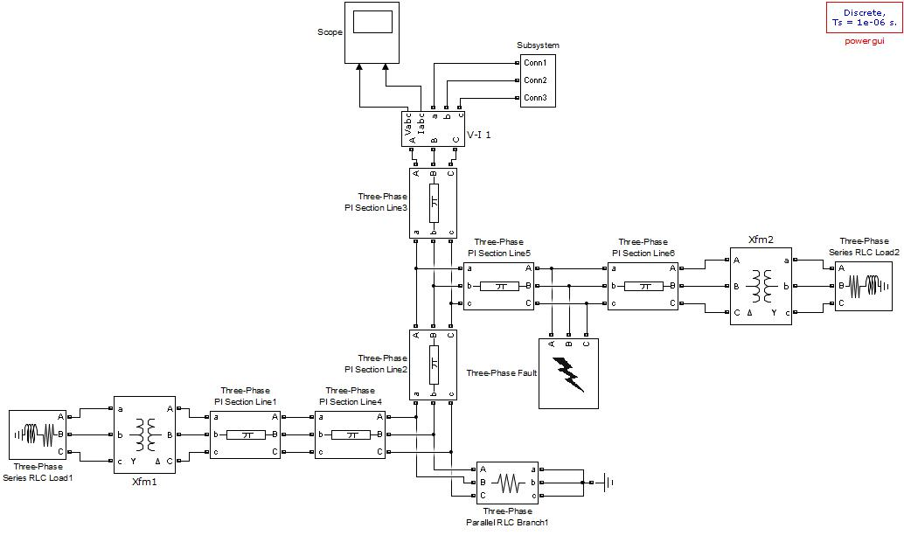
FAS
SVM
PSO
Proposed method
Simulation Results
Conclusion
SVM using PSO and its variants
Fig. 17 Diagram of the sample system
Notes:
Astley and Fombrun, 1983 -- Dependence on economic individual (1.Alliance of vertical interdependent; 2. Alliance of horizontal independent; 3. Alliance of opposite relation)
Porter and Fuller, 1986 --Valued activities (1. R&D alliance; 2. Operation and logistics alliance; 3. Marketing and service alliance; 4. Multiple activities)
-- Geographic location (1. Single country alliance; 2. Multinational alliance)
-- Activities in the industry value chain (1. X alliance: alliance of vertical specialization; 2. Y alliance: alliance of horizontal specialization
Lei and Slocum, 1992 -- Cooperative strategic focal point (1. Authorized; 2. Joint venture; 3. Alliance in common R&D).
Lorange, 1998 -- Alliance partners interdependent extent (1. Equity; 2. Non-equity; 3. Marketing/managerial service agreement; 4. Specialized knowledge authorization; 5. Franchise authorization; 6. Patent authorization; 7. Production/assemble/purchase agreement)

Slide 29
FAS
SVM
PSO
Proposed method
Simulation Results
Conclusion
Training and testing samples
To test PSO algorithms, ten types of faults are created at 100 different locations of the feeder and two laterals length.
The fault resistance values are varied over the values of 1, 5, 20, 30 and 60 during the simulation.
The number of samples generated is: 10 x 100 x 5 = 5000 patterns
- Training and validation set: 2000 patterns each
- Testing set: 1000 patterns
Notes:
Astley and Fombrun, 1983 -- Dependence on economic individual (1.Alliance of vertical interdependent; 2. Alliance of horizontal independent; 3. Alliance of opposite relation)
Porter and Fuller, 1986 --Valued activities (1. R&D alliance; 2. Operation and logistics alliance; 3. Marketing and service alliance; 4. Multiple activities)
-- Geographic location (1. Single country alliance; 2. Multinational alliance)
-- Activities in the industry value chain (1. X alliance: alliance of vertical specialization; 2. Y alliance: alliance of horizontal specialization
Lei and Slocum, 1992 -- Cooperative strategic focal point (1. Authorized; 2. Joint venture; 3. Alliance in common R&D).
Lorange, 1998 -- Alliance partners interdependent extent (1. Equity; 2. Non-equity; 3. Marketing/managerial service agreement; 4. Specialized knowledge authorization; 5. Franchise authorization; 6. Patent authorization; 7. Production/assemble/purchase agreement)

Slide 30
FAS
SVM
PSO
Proposed method
Simulation Results
Conclusion
PSO-based SVM
Table 4 Results of ANN/SVM classifier without consideration of PSO
Classifier | No. of features | Classification accuracy (%) | Training time (s)
ANN | 12 | 86.33 | 179.50
SVM | 12 | 91.12 | 134.80
Table 5 Results of ANN/SVM classifier with consideration of PSO
Classifier | No. of features | Classification accuracy (%) | Training time (s)
ANN | 8 | 93.85 | 97.95
SVM | 8 | 97.15 | 83.54
Notes:
Astley and Fombrun, 1983 -- Dependence on economic individual (1.Alliance of vertical interdependent; 2. Alliance of horizontal independent; 3. Alliance of opposite relation)
Porter and Fuller, 1986 --Valued activities (1. R&D alliance; 2. Operation and logistics alliance; 3. Marketing and service alliance; 4. Multiple activities)
-- Geographic location (1. Single country alliance; 2. Multinational alliance)
-- Activities in the industry value chain (1. X alliance: alliance of vertical specialization; 2. Y alliance: alliance of horizontal specialization
Lei and Slocum, 1992 -- Cooperative strategic focal point (1. Authorized; 2. Joint venture; 3. Alliance in common R&D).
Lorange, 1998 -- Alliance partners interdependent extent (1. Equity; 2. Non-equity; 3. Marketing/managerial service agreement; 4. Specialized knowledge authorization; 5. Franchise authorization; 6. Patent authorization; 7. Production/assemble/purchase agreement)

Slide 31
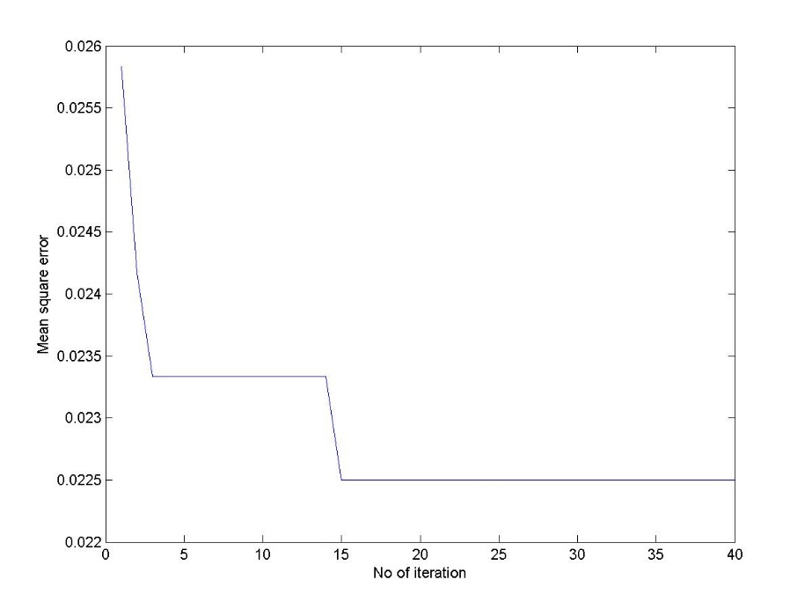
FAS
SVM
PSO
Proposed method
Simulation Results
Conclusion
PSO-based SVM
Fig. 18 Convergence characteristic of the proposed PSO
Notes:
Astley and Fombrun, 1983 -- Dependence on economic individual (1.Alliance of vertical interdependent; 2. Alliance of horizontal independent; 3. Alliance of opposite relation)
Porter and Fuller, 1986 --Valued activities (1. R&D alliance; 2. Operation and logistics alliance; 3. Marketing and service alliance; 4. Multiple activities)
-- Geographic location (1. Single country alliance; 2. Multinational alliance)
-- Activities in the industry value chain (1. X alliance: alliance of vertical specialization; 2. Y alliance: alliance of horizontal specialization
Lei and Slocum, 1992 -- Cooperative strategic focal point (1. Authorized; 2. Joint venture; 3. Alliance in common R&D).
Lorange, 1998 -- Alliance partners interdependent extent (1. Equity; 2. Non-equity; 3. Marketing/managerial service agreement; 4. Specialized knowledge authorization; 5. Franchise authorization; 6. Patent authorization; 7. Production/assemble/purchase agreement)

Slide 32
FAS
SVM
PSO
Proposed method
Simulation Results
Conclusion
Mutant PSO-based SVM
Table 6 Results of SVM classifier using mutant PSO
Classifier | C | γ | Classification accuracy (%) | Training time (sec)
Straight-SVM | 100 | 0.33 | 91.12 | 134.80
PSO-SVM | 97.2221 | 8.2346 | 95.08 | 106.20
Mutant PSO-SVM | 16.7634 | 5.7330 | 96.00 | 98.67
Notes:
Astley and Fombrun, 1983 -- Dependence on economic individual (1.Alliance of vertical interdependent; 2. Alliance of horizontal independent; 3. Alliance of opposite relation)
Porter and Fuller, 1986 --Valued activities (1. R&D alliance; 2. Operation and logistics alliance; 3. Marketing and service alliance; 4. Multiple activities)
-- Geographic location (1. Single country alliance; 2. Multinational alliance)
-- Activities in the industry value chain (1. X alliance: alliance of vertical specialization; 2. Y alliance: alliance of horizontal specialization
Lei and Slocum, 1992 -- Cooperative strategic focal point (1. Authorized; 2. Joint venture; 3. Alliance in common R&D).
Lorange, 1998 -- Alliance partners interdependent extent (1. Equity; 2. Non-equity; 3. Marketing/managerial service agreement; 4. Specialized knowledge authorization; 5. Franchise authorization; 6. Patent authorization; 7. Production/assemble/purchase agreement)

Slide 33
FAS
SVM
PSO
Proposed method
Simulation Results
Conclusion
DPSO-based SVM
Table 7 Results of SVM classifier using DPSO
classifier | C | γ | Classification Accuracy (%)
Straight-SVM | 100 | 0.33 | 91.12
DPSO-SVM (single-stage model) | 2.0817 | 4.2174 | 96.50
DPSO-SVM (multiple-stage model) | 47.4570 | 1.0864 | 98.50
Notes:
Astley and Fombrun, 1983 -- Dependence on economic individual (1.Alliance of vertical interdependent; 2. Alliance of horizontal independent; 3. Alliance of opposite relation)
Porter and Fuller, 1986 --Valued activities (1. R&D alliance; 2. Operation and logistics alliance; 3. Marketing and service alliance; 4. Multiple activities)
-- Geographic location (1. Single country alliance; 2. Multinational alliance)
-- Activities in the industry value chain (1. X alliance: alliance of vertical specialization; 2. Y alliance: alliance of horizontal specialization
Lei and Slocum, 1992 -- Cooperative strategic focal point (1. Authorized; 2. Joint venture; 3. Alliance in common R&D).
Lorange, 1998 -- Alliance partners interdependent extent (1. Equity; 2. Non-equity; 3. Marketing/managerial service agreement; 4. Specialized knowledge authorization; 5. Franchise authorization; 6. Patent authorization; 7. Production/assemble/purchase agreement)

Slide 34
FAS
SVM
PSO
Proposed method
Simulation Results
Conclusion
DPSO-based SVM
Single-stage SVM
Multiple-stage SVM
Fig. 19 Convergence characteristic of the DPSO
Notes:
Astley and Fombrun, 1983 -- Dependence on economic individual (1.Alliance of vertical interdependent; 2. Alliance of horizontal independent; 3. Alliance of opposite relation)
Porter and Fuller, 1986 --Valued activities (1. R&D alliance; 2. Operation and logistics alliance; 3. Marketing and service alliance; 4. Multiple activities)
-- Geographic location (1. Single country alliance; 2. Multinational alliance)
-- Activities in the industry value chain (1. X alliance: alliance of vertical specialization; 2. Y alliance: alliance of horizontal specialization
Lei and Slocum, 1992 -- Cooperative strategic focal point (1. Authorized; 2. Joint venture; 3. Alliance in common R&D).
Lorange, 1998 -- Alliance partners interdependent extent (1. Equity; 2. Non-equity; 3. Marketing/managerial service agreement; 4. Specialized knowledge authorization; 5. Franchise authorization; 6. Patent authorization; 7. Production/assemble/purchase agreement)

Slide 35
FAS
SVM
PSO
Proposed method
Simulation Results
Conclusion
DPSO-based SVM
Table 8 Effects of the results by varying training and testing datasets
(Training : testing) | SVM1 |  | SVM2 |  | SVM3 |  | SVM4 |  | Classification accuracy
 | C | γ | C | γ | C | γ | C | γ
60:40 | 7.98 | 5 | 47.28 | 0.01 | 4.67 | 0.07 | 100 | 0.01 | 97.46
70:30 | 100 | 1.78 | 62.09 | 0.02 | 92.77 | 0.01 | 1.03 | 0.01 | 97.89
80:20 | 56.48 | 0.74 | 4.86 | 0.01 | 69.04 | 0.02 | 40.82 | 0.07 | 98.07
90:10 | 16.44 | 1.74 | 21.47 | 0.01 | 53.19 | 0.02 | 52.94 | 0.06 | 98.50
Notes:
Astley and Fombrun, 1983 -- Dependence on economic individual (1.Alliance of vertical interdependent; 2. Alliance of horizontal independent; 3. Alliance of opposite relation)
Porter and Fuller, 1986 --Valued activities (1. R&D alliance; 2. Operation and logistics alliance; 3. Marketing and service alliance; 4. Multiple activities)
-- Geographic location (1. Single country alliance; 2. Multinational alliance)
-- Activities in the industry value chain (1. X alliance: alliance of vertical specialization; 2. Y alliance: alliance of horizontal specialization
Lei and Slocum, 1992 -- Cooperative strategic focal point (1. Authorized; 2. Joint venture; 3. Alliance in common R&D).
Lorange, 1998 -- Alliance partners interdependent extent (1. Equity; 2. Non-equity; 3. Marketing/managerial service agreement; 4. Specialized knowledge authorization; 5. Franchise authorization; 6. Patent authorization; 7. Production/assemble/purchase agreement)

Slide 36
FAS
SVM
PSO
Proposed method
Simulation Results
Conclusion
PPSO-based SVM
Table 9 Performance with some of popular variants of PSO and PPSO
SVM | Optimum SVM parameters |  | Accuracy | Run time
 | C |  | (%) | (seconds)
Straight-SVM | 100 | 0.33 | 91.12 | 134.8
With C-PSO | 107.17 | 1.10 | 96.16 | 142.8
With T-PSO | 206.17 | 3.75 | 96.87 | 112.1
With K-PSO | 384.85 | 0.61 | 96.87 | 109.3
With PC-PSO | 304.04 | 0.50 | 96.25 | 122.5
With PT-PSO | 221.21 | 2.85 | 96.96 | 119.9
With PK-PSO | 186.75 | 0.92 | 97.23 | 102.0
Notes:
Astley and Fombrun, 1983 -- Dependence on economic individual (1.Alliance of vertical interdependent; 2. Alliance of horizontal independent; 3. Alliance of opposite relation)
Porter and Fuller, 1986 --Valued activities (1. R&D alliance; 2. Operation and logistics alliance; 3. Marketing and service alliance; 4. Multiple activities)
-- Geographic location (1. Single country alliance; 2. Multinational alliance)
-- Activities in the industry value chain (1. X alliance: alliance of vertical specialization; 2. Y alliance: alliance of horizontal specialization
Lei and Slocum, 1992 -- Cooperative strategic focal point (1. Authorized; 2. Joint venture; 3. Alliance in common R&D).
Lorange, 1998 -- Alliance partners interdependent extent (1. Equity; 2. Non-equity; 3. Marketing/managerial service agreement; 4. Specialized knowledge authorization; 5. Franchise authorization; 6. Patent authorization; 7. Production/assemble/purchase agreement)

Slide 37
FAS
SVM
PSO
Proposed method
Simulation Results
Conclusion
Comparison of optimization algorithms
Table 10 Performance with various optimization algorithms
Classifier | C | γ | Classification accuracy (%)
PSO-SVM | 97.2221 | 8.2346 | 95.08
Mutant PSO-SVM | 16.7634 | 5.7330 | 96.00
GA-SVM | 3.4218 | 3.1067 | 96.42
DPSO-SVM | 2.0817 | 4.2174 | 96.50
PPSO-SVM | 186.75 | 0.92 | 97.23
Notes:
Astley and Fombrun, 1983 -- Dependence on economic individual (1.Alliance of vertical interdependent; 2. Alliance of horizontal independent; 3. Alliance of opposite relation)
Porter and Fuller, 1986 --Valued activities (1. R&D alliance; 2. Operation and logistics alliance; 3. Marketing and service alliance; 4. Multiple activities)
-- Geographic location (1. Single country alliance; 2. Multinational alliance)
-- Activities in the industry value chain (1. X alliance: alliance of vertical specialization; 2. Y alliance: alliance of horizontal specialization
Lei and Slocum, 1992 -- Cooperative strategic focal point (1. Authorized; 2. Joint venture; 3. Alliance in common R&D).
Lorange, 1998 -- Alliance partners interdependent extent (1. Equity; 2. Non-equity; 3. Marketing/managerial service agreement; 4. Specialized knowledge authorization; 5. Franchise authorization; 6. Patent authorization; 7. Production/assemble/purchase agreement)

Slide 38
FAS
SVM
PSO
Proposed method
Simulation Results
Conclusion
Summary
PSO and its variants are capacity of solving benchmark problems and improving the performance of the ANN/SVM fault classifiers.
The novel developed PSO algorithms (Mutant PSO, DPSO, PPSO) is able to help particles escaping the local minima.
The multiple-stage SVM classifier gives better classification accuracy than that obtained by the single-stage SVM model.
The novel PPSO algorithm gives the best results as compared to GA, PSO and the other variants of PSO, such as Mutant PSO, DPSO.
The PP-PSO variant gives the highest classification accuracy in the shortest time among the newly developed algorithms.
Provision of a higher training dataset gives better result versus that performed with a lower dataset.
Notes:
Astley and Fombrun, 1983 -- Dependence on economic individual (1.Alliance of vertical interdependent; 2. Alliance of horizontal independent; 3. Alliance of opposite relation)
Porter and Fuller, 1986 --Valued activities (1. R&D alliance; 2. Operation and logistics alliance; 3. Marketing and service alliance; 4. Multiple activities)
-- Geographic location (1. Single country alliance; 2. Multinational alliance)
-- Activities in the industry value chain (1. X alliance: alliance of vertical specialization; 2. Y alliance: alliance of horizontal specialization
Lei and Slocum, 1992 -- Cooperative strategic focal point (1. Authorized; 2. Joint venture; 3. Alliance in common R&D).
Lorange, 1998 -- Alliance partners interdependent extent (1. Equity; 2. Non-equity; 3. Marketing/managerial service agreement; 4. Specialized knowledge authorization; 5. Franchise authorization; 6. Patent authorization; 7. Production/assemble/purchase agreement)

Slide 39
FAS
SVM
PSO
Proposed method
Simulation Results
Conclusion
Conclusion
Developing three novel variants of PSO, Mutant PSO, DPSO and PPSO
Testing PSO algorithms successfully on five Benchmark Problems.
Constructing the ANN/SVM classifier using PSO and its variants to diagnose fault in distribution system.
Result: By using PSO, the classification accuracy of both classifiers reach over 93%. Especially, in case of using the proposed variants of PSO, this rate increases to over 97% and particles can escape from the local minima.
Notes:
Astley and Fombrun, 1983 -- Dependence on economic individual (1.Alliance of vertical interdependent; 2. Alliance of horizontal independent; 3. Alliance of opposite relation)
Porter and Fuller, 1986 --Valued activities (1. R&D alliance; 2. Operation and logistics alliance; 3. Marketing and service alliance; 4. Multiple activities)
-- Geographic location (1. Single country alliance; 2. Multinational alliance)
-- Activities in the industry value chain (1. X alliance: alliance of vertical specialization; 2. Y alliance: alliance of horizontal specialization
Lei and Slocum, 1992 -- Cooperative strategic focal point (1. Authorized; 2. Joint venture; 3. Alliance in common R&D).
Lorange, 1998 -- Alliance partners interdependent extent (1. Equity; 2. Non-equity; 3. Marketing/managerial service agreement; 4. Specialized knowledge authorization; 5. Franchise authorization; 6. Patent authorization; 7. Production/assemble/purchase agreement)

Slide 40
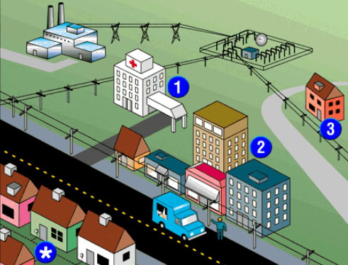
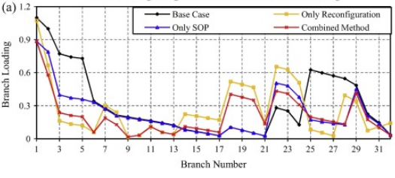
FAS
SVM
PSO
Proposed method
Simulation Results
Conclusion
Future Research
Load balance among feeders:
Use PSO-based ANN/SVM to control the switch closing sequence of each load for the minimum power loss which will lead to the optimal phase balance
黃裕泰
Power system restoration:
Use PSO-based SVM for prediction of fault classification before restoration of the power system in order to achieve fast and reliable restoration.
Notes:
Astley and Fombrun, 1983 -- Dependence on economic individual (1.Alliance of vertical interdependent; 2. Alliance of horizontal independent; 3. Alliance of opposite relation)
Porter and Fuller, 1986 --Valued activities (1. R&D alliance; 2. Operation and logistics alliance; 3. Marketing and service alliance; 4. Multiple activities)
-- Geographic location (1. Single country alliance; 2. Multinational alliance)
-- Activities in the industry value chain (1. X alliance: alliance of vertical specialization; 2. Y alliance: alliance of horizontal specialization
Lei and Slocum, 1992 -- Cooperative strategic focal point (1. Authorized; 2. Joint venture; 3. Alliance in common R&D).
Lorange, 1998 -- Alliance partners interdependent extent (1. Equity; 2. Non-equity; 3. Marketing/managerial service agreement; 4. Specialized knowledge authorization; 5. Franchise authorization; 6. Patent authorization; 7. Production/assemble/purchase agreement)

Slide 41
Publication List Since 2016
A. SCI (Journal Citation Record) papers:
[1] Thi Thom Hoang*, Ming Yuan Cho, Mahamad Nabab Alam, Quoc Tuan Vu, 2018, A novel differential particle swarm optimization for parameter selection vector machines for monitoring metal-oxide surge arrester conditions, Swarm and Evolutionary Computation. Vol. 38, pp: 120-126 (SCI, JCR 2017 Journal impact factor: 3.893).
[2] Ming Yuan Cho, Thi Thom Hoang*, 2017, Feature Selection and Parameters Optimization of SVM using Particle Swarm Optimization for Fault Classification in Power Distribution Systems, Computational Intelligence and Neuroscience, vol. 2017, pp. 1-9 (SCI, JCR 2017 Journal impact factor: 1.215).
[3] Ming Yuan Cho, Thi Thom Hoang*, 2017, A Differential Particle Swarm Optimization-based Support Vector Machine Classifier for Fault Diagnosis in Power Distribution Systems, Advances in Electrical and Computer Engineering, Vol. 17, No. 3, pp. 51-60 (SCI, JCR 2017 Journal impact factor: 0.595).
[4] Thi Thom Hoang*, Ming Yuan Cho, Quoc Tuan Vu, 2017, A novel Perturbed Particle Swarm Optimization-based Support Vector Machine for fault diagnosis in power distribution systems, TURKISH JOURNAL OF ELECTRICAL ENGINEERING & COMPUTER SCIENCES, DOI: 10.3906/elk-1705-241, (SCI, JCR 2017 Journal impact factor: 0.578).
[5] Thi Thom Hoang*, Ming Yuan Cho, Mahamad Nabab Alam, A Newly Enhanced Support Vector Machine using Variants of Particle Swarm Optimization for Power Distribution System Fault Diagnosis, Swarm and Evolutionary Computation. Accepted. (SCI, JCR 2017 Journal impact factor: 3.893).
[6] Chien-Nan Chen, Thi Thom Hoang*, Ming Yuan Cho, “An enhanced Support Vector Machine for Diagnosis of Metal-oxide Surge Arrester Conditions,” Computational Intelligence and Neuroscience, Under review (SCI, JCR 2017 Journal impact factor: 1.215).
Notes:
Astley and Fombrun, 1983 -- Dependence on economic individual (1.Alliance of vertical interdependent; 2. Alliance of horizontal independent; 3. Alliance of opposite relation)
Porter and Fuller, 1986 --Valued activities (1. R&D alliance; 2. Operation and logistics alliance; 3. Marketing and service alliance; 4. Multiple activities)
-- Geographic location (1. Single country alliance; 2. Multinational alliance)
-- Activities in the industry value chain (1. X alliance: alliance of vertical specialization; 2. Y alliance: alliance of horizontal specialization
Lei and Slocum, 1992 -- Cooperative strategic focal point (1. Authorized; 2. Joint venture; 3. Alliance in common R&D).
Lorange, 1998 -- Alliance partners interdependent extent (1. Equity; 2. Non-equity; 3. Marketing/managerial service agreement; 4. Specialized knowledge authorization; 5. Franchise authorization; 6. Patent authorization; 7. Production/assemble/purchase agreement)

Slide 42
Publication List Since 2016
B. ESCI papers:
[1] Ming Yuan Cho, Thi Thom Hoang*, 2017, Fault Diagnosis for Distribution Networks using enhanced Support Vector Machine classifier with Classical Multidimensional Scaling, Journal of Electrical Systems, Vol. 13, No. 3, pp.415-428.
C. EI papers:
[1] Ming Yuan Cho, Hoang Thi Thom*, Jeng Feng Hsu, 2016, Fault Diagnosis for High Voltage Distribution Networks using Pseudorandom Binary Sequence and Cross Correlation Technique, International Conference on Green Technology and Sustainable Development (GTSD) 2016. DOI: 0.1109/GTSD.2016.51, pp.185-190.
[2] Ming Yuan Cho, Hsin Yi Huang, Chien Nan Chen, Hoang Thi Thom, Pei Ru Wang, Wen Yao Chang, Chin Tun Wang, 2016, The implementation and Application of Low Voltage Distribution Line Theft Supervisory System," International Conference on Green Technology and Sustainable Development (GTSD) 2016. DOI: 10.1109/GTSD.2016.50, pp.178-184.
D. Conference Papers:
[1] Hoang Thi Thom*, Hung-Chang Hsu, Ming Yuan Cho, Mahamad Nabab Alam, "Mutant particle swarm optimization based on support vector machine for fault diagnosis in power distribution systems," International Conference on Smart Grid Technology and Data Processing (SGTDP) 2017, IET Proceedings. (EI, INSPEC).
E. Book Chapter:
[1] Mahamad Nabab Alam, Thi Thom Hoang*, Chapter 4. Application of Particle Swarm Optimization for solving Electrical Engineering Problems, pp. 61-86, Book: Focus on Swarm Intelligence Research and Applications, Nova Science Publisher, Inc., 2017.
Notes:
Astley and Fombrun, 1983 -- Dependence on economic individual (1.Alliance of vertical interdependent; 2. Alliance of horizontal independent; 3. Alliance of opposite relation)
Porter and Fuller, 1986 --Valued activities (1. R&D alliance; 2. Operation and logistics alliance; 3. Marketing and service alliance; 4. Multiple activities)
-- Geographic location (1. Single country alliance; 2. Multinational alliance)
-- Activities in the industry value chain (1. X alliance: alliance of vertical specialization; 2. Y alliance: alliance of horizontal specialization
Lei and Slocum, 1992 -- Cooperative strategic focal point (1. Authorized; 2. Joint venture; 3. Alliance in common R&D).
Lorange, 1998 -- Alliance partners interdependent extent (1. Equity; 2. Non-equity; 3. Marketing/managerial service agreement; 4. Specialized knowledge authorization; 5. Franchise authorization; 6. Patent authorization; 7. Production/assemble/purchase agreement)

Slide 43



Thank You
for
Listening to My Presentation

