Slide 1
MẠNG CẢM BIẾN KHÔNG DÂY (WSN) VÀ KHẢ NĂNG ỨNG DỤNG TRONG THỦY SẢN
NGUYỄN VĂN HÂN
Bộ môn: Điện tử - Tự động
Khoa: Điện – Điện tử
Trường Đại học Nha Trang
Email: hannv@ntu.edu.vn

Slide 2
NỘI DUNG
GIỚI THIỆU WSN
GIỚI THIỆU ZIGBEE
KHẢ NĂNG ỨNG DỤNG WSN TRONG THỦY SẢN

Slide 3
GIỚI THIỆU
Mạng cảm biến không dây (Wireless Sensor Networks)
  Wireless Sensor Networks are networks that consists of sensors which are distributed in an ad hoc manner.
  These sensors work with each other to sense some physical phenomenon and then the information gathered is processed to get relevant results.
  Wireless sensor networks consists of protocols and algorithms with self-organizing capabilities.

Slide 4
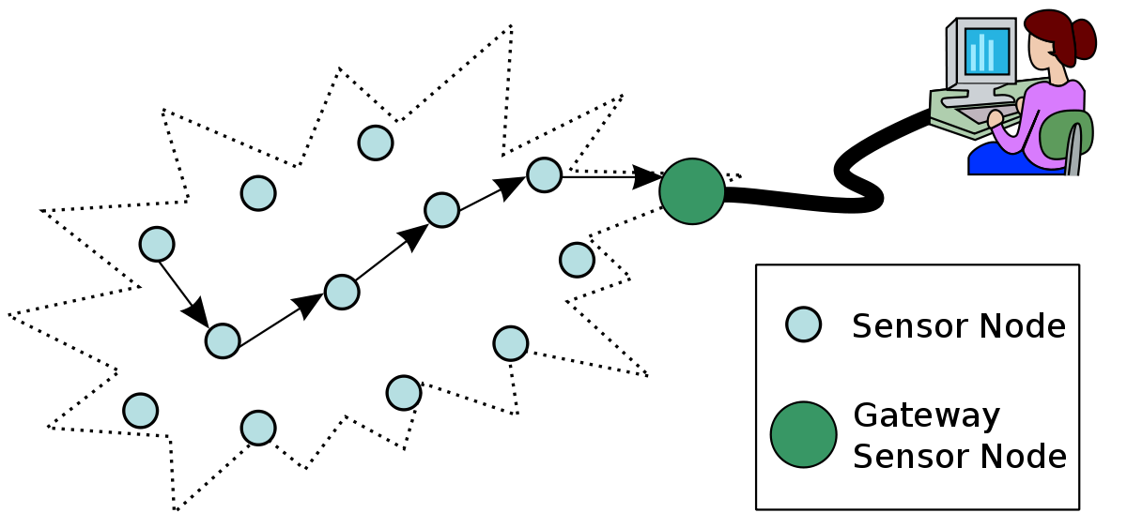
GIỚI THIỆU

Slide 5
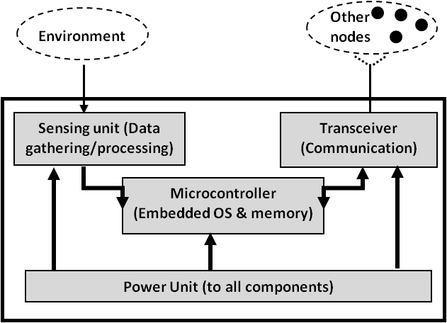
GIỚI THIỆU
WSN Sensor nodes are equipped with sensing, limited computation, and wireless communication capabilities.

Slide 6
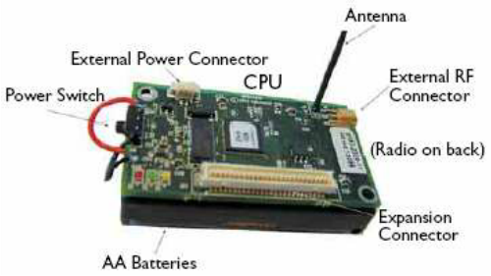
SENSOR NODE

Slide 7
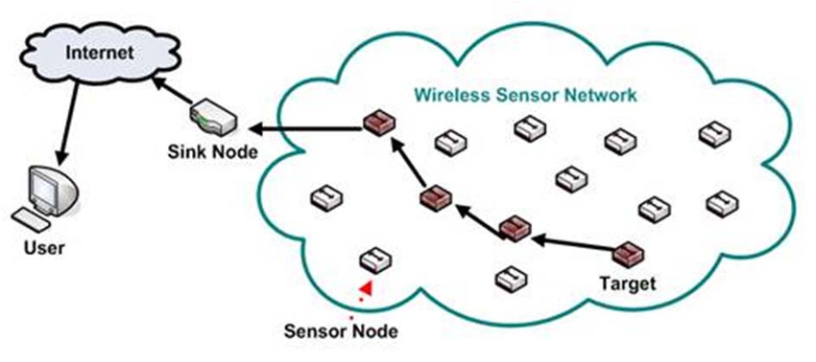
NGUYÊN LÝ WSN
ROUTING

Slide 8
ĐẶC ĐIỂM WSN
Wireless Sensor Networks mainly consists of sensors. Sensors are -
  low power
  limited memory
  energy constrained due to their small size.
Wireless networks can also be deployed in extreme environmental conditions and may be prone to enemy attacks.
Although deployed in an ad hoc manner they need to be self organized and self healing and can face constant reconfiguration

Slide 9
Design Challenges
Heterogeneity (Tính không đồng nhất)
  The devices deployed maybe of various types and need to collaborate with each other.
Distributed Processing (Xử lý phân tán)
  The algorithms need to be centralized as the processing is carried out on different nodes.
Low Bandwidth Communication (Băng thông hẹp)
  The data should be transferred efficiently between sensors

Slide 10
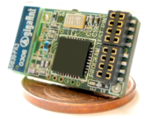
Continued..
Large Scale Coordination (Phạm vi phối hợp hoạt động rộng)
  The sensors need to coordinate with each other to produce required results.
Utilization of Sensors (phân bố các cảm biến)
  The sensors should be utilized in a ways that produce the maximum performance and use less energy.
Real Time Computation (tính toán trong thời gian thực)
  The computation should be done quickly as new data is always being generated.

Slide 11
Operational Challenges of Wireless Sensor Networks
Energy Efficiency
Limited storage and computation
Low bandwidth and high error rates
Errors are common
  Wireless communication
  Noisy measurements
  Node failure are expected
Scalability to a large number of sensor nodes
Survivability in harsh environments

Slide 12
Applications of Wireless Sensor networks
The applications can be divided in three categories:
Monitoring of objects.
Monitoring of an area.
Monitoring of both area and objects.

Slide 13
Monitoring Area
Environmental and Habitat Monitoring
Precision Agriculture
Indoor Climate Control
Military Surveillance
Treaty Verification
Intelligent Alarms

Slide 14
Monitoring Objects
Structural Monitoring
Eco-physiology
Condition-based Maintenance
Medical Diagnostics
Urban terrain mapping

Slide 15
Monitoring Interactions between Objects and Space
Wildlife Habitats
Disaster Management
Emergency Response
Ubiquitous Computing
Asset Tracking
Health Care
Manufacturing Process Flows

Slide 16
What is ZigBee?
Technological Standard Created for Control and Sensor Networks
Based on the IEEE 802.15.4 Standard
Created by the ZigBee Alliance

Slide 17

IEEE 802.15.4 & ZigBee In Context
Application
Customer
  “the software”
  Network, Security & Application layers
  Brand management
IEEE 802.15.4
  “the hardware”
  Physical & Media Access Control layers
API
Security
32- / 64- / 128-bit encryption
ZigBee
Alliance
Network
Star / Mesh / Cluster-Tree
MAC
IEEE
802.15.4
PHY
868MHz / 915MHz / 2.4GHz
Silicon
Stack
App
Source: http://www.zigbee.org/resources/documents/IWAS_presentation_Mar04_Designing_with_802154_and_zigbee.ppt

Slide 18
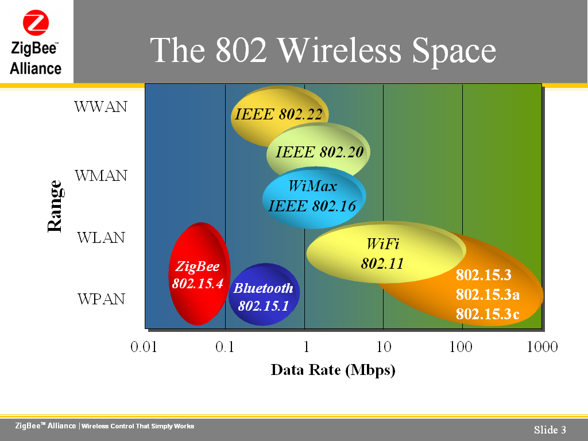
The 802 Wireless Space
Source: http://www.zigbee.org/en/resources/

Slide 19
ZigBee Aims Low
Low data rate
Low power consumption
Small packet devices

Slide 20
ZigBee Frequencies
Operates in Unlicensed Bands
ISM 2.4 GHz Global Band at 250kbps
868 MHz European Band at 20kbps
915 MHz North American Band at 40kbps

Slide 21
What Does ZigBee Do?
Designed for wireless controls and sensors
Operates in Personal Area Networks (PAN’s) and device-to-device networks
Connectivity between small packet devices
Control of lights, switches, thermostats, appliances, etc.

Slide 22
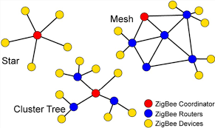
ZIGBEE TOPOLOGIES

Slide 23
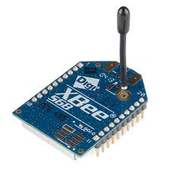
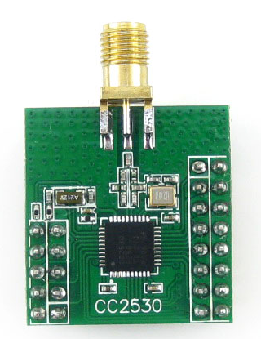
ZIGBEE NODE
XBEE NODE (Digi)
C2530 (TI)

Slide 24
ỨNG DỤNG TRONG THỦY SẢN
KHAI THÁC THỦY SẢN
  Giám sát, điều khiển nhiệt độ hầm lạnh trên tàu khai thác
  Báo cáo khai thác
    Gắn sensor vào tời lưới → tự động báo cáo số mẻ lưới
    Nhập số liệu thủ công qua HMI
  Giám sát các thông số của máy tàu

Slide 25
ỨNG DỤNG TRONG THỦY SẢN
CHẾ BIẾN THỦY SẢN
  Giám sát, điều khiển nhiệt độ, nồng độ khí CO₂, SO₂,… trong kho lạnh
  Truy xuất nguồn gốc thủy sản
  Quản lý chất lượng thủy sản

Slide 26
ỨNG DỤNG TRONG THỦY SẢN
NUÔI TRỒNG THỦY SẢN
  Giám sát, điều khiển các thông số môi trường (nhiệt độ, nồng độ khí độc,…) trong ao, hồ, lồng bè nuôi thủy sản
  Quản lý lượng thức ăn, thuốc

Slide 27
THANK YOU
Q&A?

